Slide 1
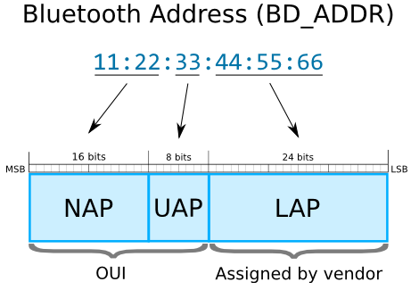
Bluetooth Address Structure
Bluetooth Address consists of three parts:
NAP, UAP and LAP.
NAP(Non-significant Address Part (2 bytes)):Contains first 16 bits of the OUI. The NAP value is used in Frequency Hopping Synchronization frames.
UAP(Upper Address Part (1 byte)):Contains remaining 8 bits of the OUI. The UAP value is used for seeding in various Bluetooth specification algorithms.
LAP(Lower Address Part (3 bytes)):This portion of Bluetooth Address is allocated by the vendor of device. The LAP value uniquely identifies a Bluetooth device as part of the Access Code in every transmitted frame.

